Slide 1
I
It’s about Justice.
It’s about democracy.
It’s about time.
Notes:
Sept 29, 2017 version with Richland and Greenville legislative delegations

Slide 2
Democracy 101
Toolkit to Repair South Carolina’s Democracy
A project of the SC Progressive Network
Notes:
Slide One: Democracy 101 (Preface)
We used to call this the Missing Voter Project, but that put too much emphasis on voting.
We’re very clear: we’re not going to vote our way out of our current mess.
We’re not going to litigate our way out either.
We’re going to have to do it the old-fashioned way—organize our way out.
We’ll talk about how today.
We start this out at schools by asking: What kind of political system do we have?
What do they say? (Democracy.) And where do we stand at practicing democracy we ask next.
What do you think students say? (“We’re number one.”)

Slide 3
Global rank of USA voter participation in advanced democracies:
31 out of 34 nations
SC ranked 39 among states with a 57% turnout in 2016
Notes:
In the U.S.,registration is an individual responsibility. And registered voters represent a much smaller share of potential voters in the U.S. than just about any other OECD country: Only about 65% of the U.S. voting-age population (and 71% of the voting-age citizenry) was registered in 2012, according to the Census Bureau, compared with 91% in Canada and the UK, 96% in Sweden and nearly 99% in Japan.
America’s voter turnout has so poor that only 36.3% of eligible voters turned out to cast votes in the 2014 midterm election. This was a low point for the U.S. because there hasn’t been a turnout this low low since 1942, a total of 72 years.
But how does the United States compare to other democratic developed countries? The Pew Research Center completed a survey of the top 34 developed countries. The U.S. ranked 31st in voter turnout. The turnout was calculated from information regarding the 2012 general election. All of the countries surveyed were part of the Organization for Economic Cooperation and Development (OECD).

Slide 4
Problems:
The USA has the least representative democracy of the world’s advanced democracies.
We are the only wealthy democracy that allows private profit to determine social policies.
Our elections resemble auctions that would be illegal in most advanced democracies, enabling corruption.
The lack of clear and comprehensive ethics laws, enforcement and funding for monitoring and investigating.
Partisan gerrymandering has resulted 74% of SC voters having only one viable candidate on their House and Senate ballot. This lack of competition allows winners play to a small, ideologically narrow base.
Notes:
1. Based on citizen participation in election and the barriers to voting.
2. like health care, sick leave, drug costs, agriculture and food policies (that result in some US grown food being banned in Europe and Japan, due to profit induced chemicals. We’re even privatizing schools and prisons.
3. Candidates who spend the most money win more than 90% of the time. If they are incumbent, their chances improve.
4. Not counting minor parties.

Slide 5
This is not what democracy looks like!
• Out of 3,022,826 registered SC voters in 2016:
• 13% - 417,000 primary voters – elected 131 of 170 legislators (77%) in the party primaries.
• 8.6% - 260,611 primary voters - chose 86 of the 108 Republicans (80%) that run the state.
• 5.3% - 158,959 primary voters – chose 45 of 62 Democrats (73%) of the Democratic legislators.
• 2,605,826 registered voters (77%) only had one major party candidate on their ballot for House and Senate.
• 125 of the 170 winners got more that 98% of the vote.
• 40% of black voters only had a white Republican to vote for to represent them in the senate.

Slide 6
This is what the best government money can buy looks like. • 94 legislators, out of 170, with no (major party) opposition the 2016 primary or general election raised $4.1+ million dollars with nothing to spend it on. • In the election leading up to the 2007 vote allowing SCE&G to begin charging ratepayers $9 billion for nuclear reactors that will never be built, electric utilities and the nuclear industry made 619 contributions totaling $514,955.92 to lawmakers who passed the bill with no debate. • The Democratic candidate for governor that year, Tommy Moore, led the Senate consideration of the SCE&G bill and received $74,750 from electric companies before he successfully moved to pass the bill on a voice vote. • SCE&G hired former Gov. McNair’s law firm to write the bill that guaranteed them a profit, even if they abandoned the project. The McNair firm gave the maximum contribution to Sen. Moore and $64,000 to legislators who voted for their bill.

Slide 7
Gerrymandering + Money = Corruption
Chamber | Party | S.C. Legislator | Primary Competition | General Competition | Winning % in General | Money raised | Corruption Probe Status as of Sept. 2017
Charleston H | R | Bobby Harrell | No | (3rd Party) No | *74% | $530,333 (2012) | Indicted 9/9/14; Pled guilty to 6 counts of misuse of campaign funds 10/23/14
Charleston H | R | Jim Merrill | No | No | 98.5% | $16,650 (2016) | Indicted on 30 counts 12/14/16; Pled guilty to misconduct in office 9/1/17; Special election 1/16/18
Richland S | R | John E. Courson | No | (*3rd Party) No | *74.5% | $199,446 (2016) | Indicted 3/16/17; suspended from legislature; case pending
Lexington H | R | Rick Quinn | Yes | No | 98.33% | $68,730 (2016) | Indicted 5/16/17; suspended; case pending

Slide 8
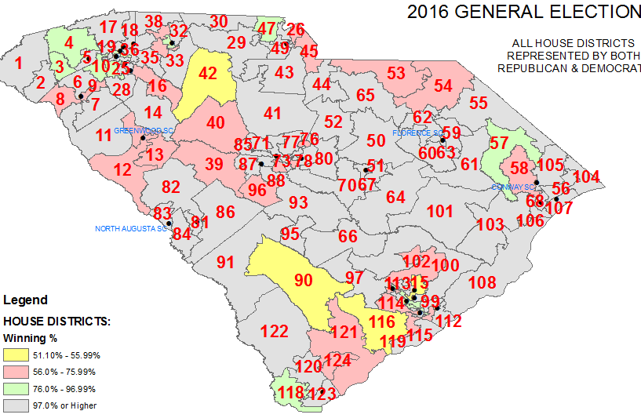
Gerrymandering: House
Notes:
Gray==Winner elected with 98%-99% of vote
Green=76-97%
Pink=56-76%
Yellow= 51-56%

Slide 9
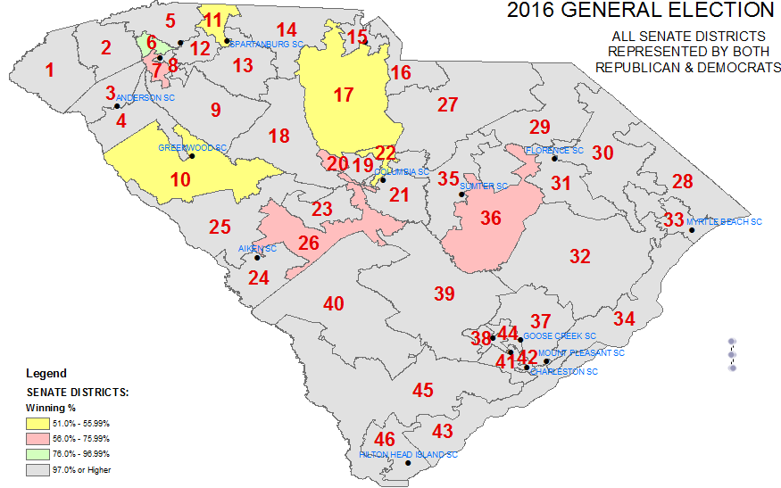
Gerrymandering: Senate
Notes:
Gray==Winner elected with 98%-99% of vote
Green=76-97%
Pink=56-76%
Yellow= 51-56%

Slide 10
Richland County Legislative Delegation
Party | Legislator | MONEY Raised | PRIMARY Competition | GENERAL Competition | Winning %
 | SENATE
D | John L. Scott, Jr. | $115,254 | Yes | No | 99.31%
D | Darrell Jackson | $108,096 | Yes | No | 98.81%
D | J. Thomas McElveen | $85,745 | No | No | 98.66%
R | John E. Courson | $199,446 | No | No* (3rd Party ) | 74.50%
D | Mia S. McLeod | $269,582 | No | Yes | 54.94%
 | HOUSE
D | Christopher R. Hart | $13,799 | No | No | 99.30%
D | Leon Howard | $30,099 | No | No | 99.29%
D | Joseph H. Neal | $5,230 | No | No | 99.23%
D | MaryGail K. Douglas | $5,300 | No | No | 99.20%
D | Joseph McEachern | $16,349 | Yes | No | 99.04%
D | J. Todd Rutherford | $45,730 | No | No | 98.94%
D | Dr. Jimmy C. Bales | $38,589 | Yes | No | 98.81%
D | Beth E. Bernstein | $17,155 | No | No | 98.58%
D | James E. Smith, Jr. | $45,493 | No | No | 98.48%
R | Nathan Ballentine | $85,414 | Yes | No | 98.14%
D | Ivory Torrey Thigpen | $49,785 | Yes | Yes | 72.96%
R | Kirkman Finlay, III | $169,805 | No | Yes | 59.41%

Slide 11
Greenville County
Party | Legislator | MONEY Raised | PRIMARY Competition | GENERAL Competition | Winning %
 | SENATE
R | Thomas Corbin | $159,736 | Yes | No | 98.98%
R | Shane R. Martin | $242,339 | No | No | 98.93%
R | Daniel Verdin III | $34,613 | No | No | 98.85%
R | Ross Turner | $178,090 | No | No | 98.59%
R | Scott Talley | $201,903 | Yes | No | 98.36%
R | William Timmons | $301,452 | Yes | No* (3rd Party) | 84.46%
D | Karl B. Allen | $71,832 | Yes | Yes | 61.86%
 | HOUSE
R | Mike Burns | $8,300 | No | No | 99.37%
R | Tommy M. Stringer | $5,000 | No | No | 99.14%
R | William M. "Bill" Chumley | $10,479 | No | No | 99.01%
R | Phyllis Henderson | $41,077 | No | No | 98.93%
R | Eric M. Bedingfield | $1,000 | No | No | 98.84%
R | Bruce W. Bannister | $106,844 | No | No | 98.79%
R | Merita A. "Rita" Allison | $60,454 | No | No | 98.69%
R | Daniel P. Hamilton | $23,024 | No | No | 98.66%
R | Dwight A. Loftis | $18,822 | No | No | 98.56%
R | Garry R. Smith | $23,082 | No | No | 98.44%
D | Chandra E. Dillard | $21,903 | No | No | 97.85%
R | Jason Elliott | $83,382 | Yes | No | 84.37%
R | Joshua A. Putnam | $14,150 | No | Yes | 81.15%
D | Leola C. Robinson-Simpson | $12,439 | No | No* (3rd Party) | 79.46%
R | Mark N. Willis | $42,919 | No | Yes | 65.34%
D | Anne Parks | $26,894 | No | Yes | 58.31%

Slide 12
Our democracy is threatened by:
• Unregulated cash that has corrupted politics.
• Corporations have become people and money is speech.
• Private profits determine public policies
• Partisan Gerrymandering has been allowed to rig elections and end representative democracy.
• Voter registration and restrictive laws suppress the vote.
• The two party system that George Washington warned against, fights for dominance over money and power and fails to serve their true mission of just governance.
• There is no popular party that holds incumbents accountable.
• Citizens who forget their history, their responsibility to resist and the hope that come from a good and noble fight.

Slide 13
To Win, We Must:
:
Focus on popular education and growing new leaders.
Work year round on issues and policies, not just on campaigns and candidates or during election cycles.
Organize outside the existing party structures to build a base on principles and shared values.
Organize strategically inside the existing party structures to build and strengthen our base.
Grow our own candidates, and the base that can hold them accountable.
Build the movement necessary for a successful party.
Walk humbly, do justice, lead by example and enjoy the long struggle for a revolution of values.
Notes:
The SC Democratic Party does none of the above.
The SC Republican Party has a clear line and holds its candidates accountable – easy because they serve the interest of a homogeneous base: wealthy white, male.
According to SC Democratic Party Chair Jamie Harrison, “the SC Progressive Network is doing what the SC Democratic Party has to do it it wants to win elections.” Base building on principles. If you stand for something, you can build your base, even if you lose.
Popular Education is a movement, a practice and a theory of social change that is based on continuious learning and committed to resisting unjust uses of power.

Slide 14
Progressive Network Mission
• To build a statewide, multi-issue, multi-racial movement with the capacity to implement our values of social justice and equality.

